Slide 1
Mission: Hanham Woods will give people the best chance of success...
Academic outcomes | Character development
Year 11 Crossover Evening. Welcome!
Josh Hocking (Year 11 Lead // Curriculum Leader of Maths)
Abi Morgan - Patel (Curriculum Leader of English)
Sara Thomas (Curriculum Leader of Science)
Notes:
Welcome – privielegd to be here today.

Slide 2
Why today? Why now?
Students have…..
3 Core Lessons left before PPE’s begin
1 Options Lessons left before PPE’s begin
And…..
48 Core Lessons left before the Summer Exams
28 Options Lessons left before the Summer Exams
Dream BIG // Work Hard // Be Kind
@HanhamWoods
Notes:
Welcome – privielegd to be here today.

Slide 3
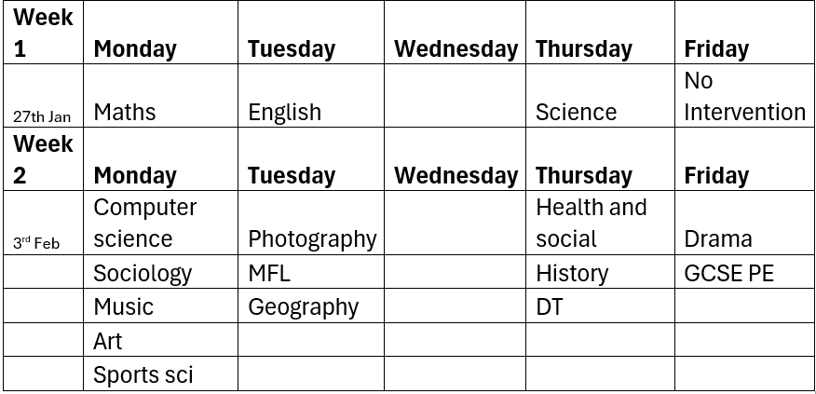
Attend After Academy Intervention
Sessions run from 3pm – 3:50pm
This is not in place of revision. It supplements it.
Dream BIG // Work Hard // Be Kind
@HanhamWoods
Notes:
Welcome – privielegd to be here today.

Slide 4
What will make the difference in Maths?
There are 3 main ways to shift the grade.
Engaging in every lesson, everyday and attending intervention
Using the exam pack effectively
Taking advantage of individual feedback – Sparx
Dream BIG // Work Hard // Be Kind
@HanhamWoods
Notes:
Welcome – privielegd to be here today.

Slide 5
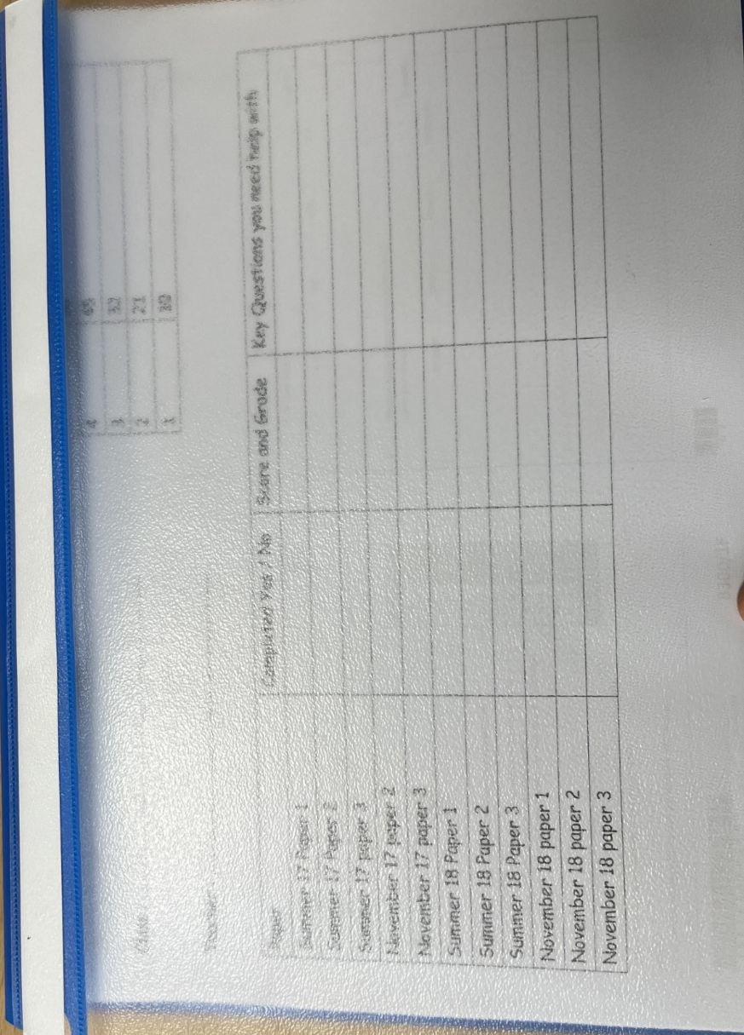
Maximising the use of the Exam Pack
The pack contains 12 past exam papers with 12 worked answers to help you check and mark your work.
Dream BIG // Work Hard // Be Kind
@HanhamWoods
Notes:
Welcome – privielegd to be here today.

Slide 6
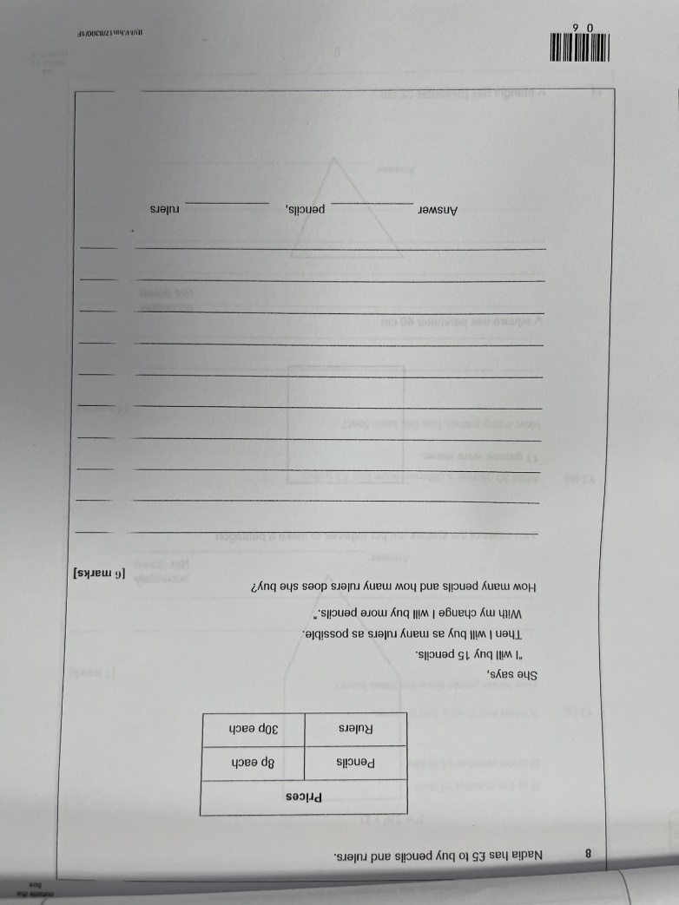
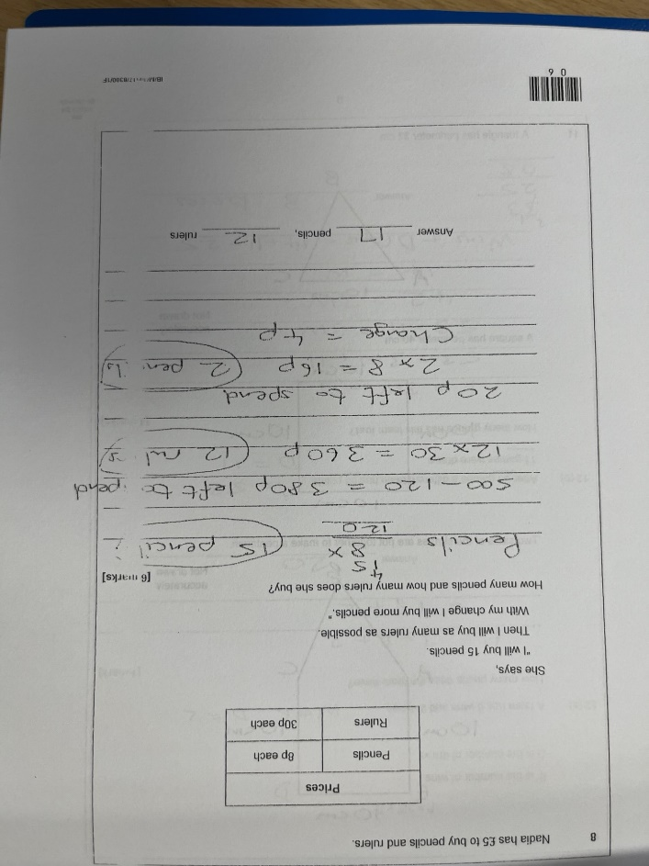
Maximising the use of the Exam Pack
Stage 1
Answer each question to the best of your ability.
Stage 2
Once completed, use the worked answers located at the end of each paper to help you mark your work.
Stage 3
Use the video solutions on YouTube by Mr Topkins EdTech. Type in ‘AQA GCSE Maths’ followed by the tier (foundation or higher), the year of the paper and the paper number.
Rewatch as many times as you like!
Dream BIG // Work Hard // Be Kind
@HanhamWoods
Notes:
Welcome – privielegd to be here today.

Slide 7
Maximising the use of the Exam Pack
How often should students be completing these papers?
Students should aim to complete 1 per week from now. This means complete it, mark it
What if a question is on something that has not been taught yet?
This is more than likely as we have not finished the course. Watch the videos and look at the solutions but raise this with your Teacher!
Are the grade boundaries on the front cover guaranteed to be like that in Summer?
No. In fact the boundaries change every year (up and down) depending upon student performance. They are there as a guide only.
When the exam pack is finished what should I do next?
Luckily we have far more papers for you to have a go at! In theory by the time you go into the exam you could complete up to 50 papers so just ask for more and we will arrange this for you.
Should some of these be completed over February Half Term?
Yes absolutely it is great revision. Try to complete at least 2.
Dream BIG // Work Hard // Be Kind
@HanhamWoods
Notes:
Welcome – privielegd to be here today.

Slide 8
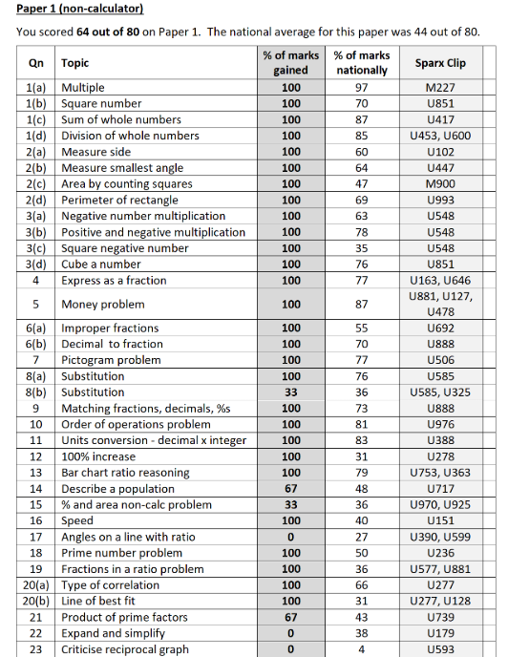
Sparx – Personalised Feedback
Dream BIG // Work Hard // Be Kind
@HanhamWoods
Notes:
Welcome – privielegd to be here today.

Slide 9
Success in English Literature and Language
Attend and engage with every lesson
Be aware of areas to improve from last mock
Attend tutor time as this is also taken by English teachers who can answer questions or run revision tasks
Attend English after school revision every other Tuesday
Read or watch the Literature texts again
Use Seneca to revise online
Complete the tasks in the English Revision Booklet
Dream BIG // Work Hard // Be Kind
@HanhamWoods
Notes:
Welcome – privielegd to be here today.

Slide 10
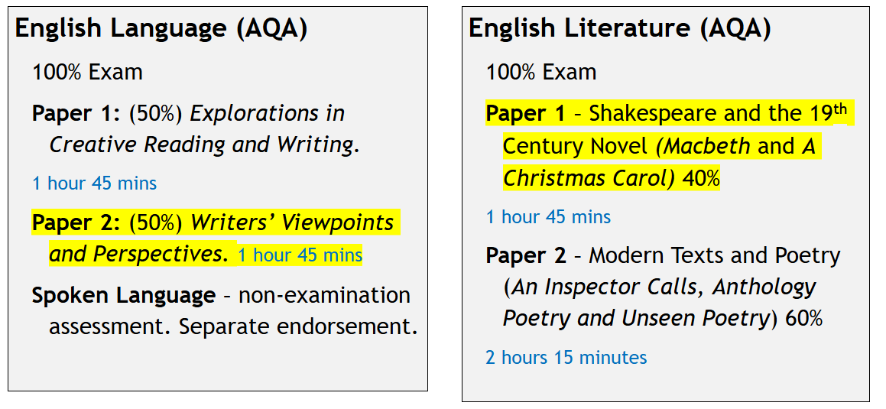
English Language and English Literature GCSE.​
Dream BIG // Work Hard // Be Kind
@HanhamWoods
Notes:
Welcome – privielegd to be here today.

Slide 11
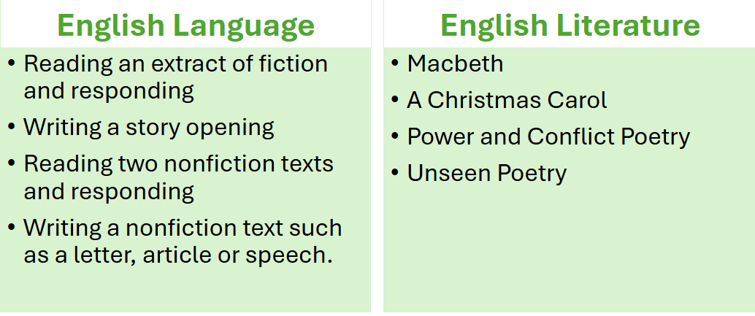
What topics are on the exam?​
Dream BIG // Work Hard // Be Kind
@HanhamWoods
Notes:
Welcome – privielegd to be here today.

Slide 12
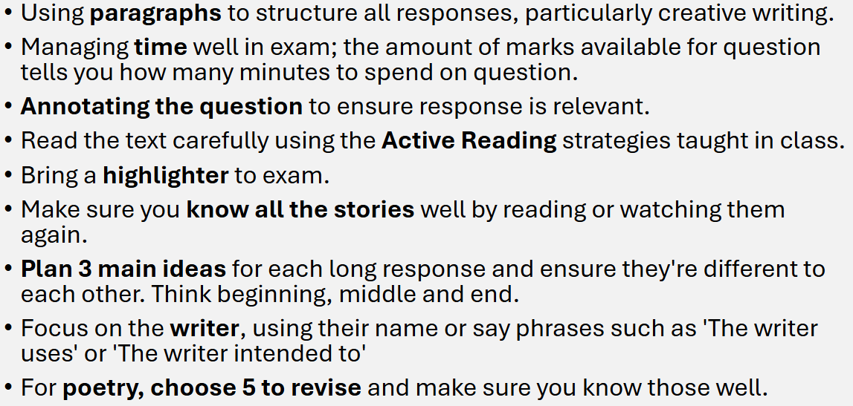
How to avoid common mistakes.​
Dream BIG // Work Hard // Be Kind
@HanhamWoods
Notes:
Welcome – privielegd to be here today.

Slide 13
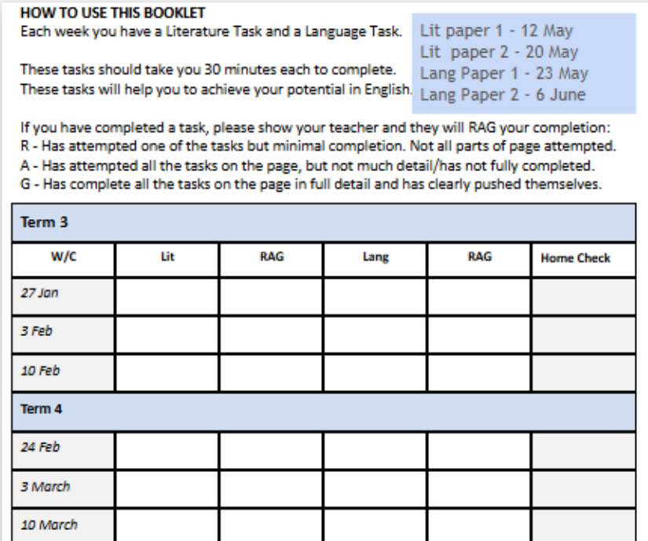
Using the Booklet ​
Dream BIG // Work Hard // Be Kind
@HanhamWoods
Notes:
Welcome – privielegd to be here today.

Slide 14
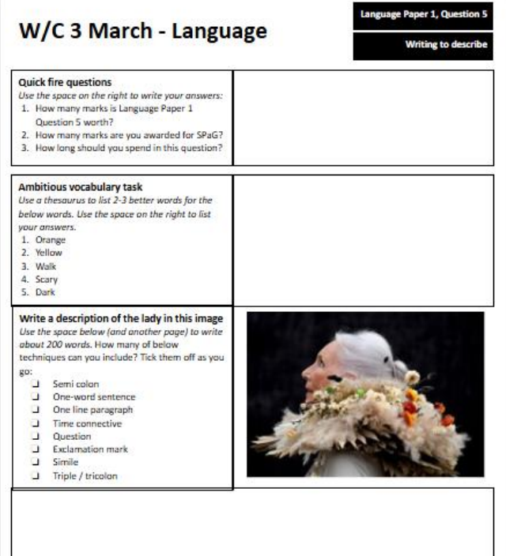
Example Task ​
Dream BIG // Work Hard // Be Kind
@HanhamWoods
Notes:
Welcome – privielegd to be here today.

Slide 15
You’ve got this! ​
Dream BIG // Work Hard // Be Kind
@HanhamWoods
Notes:
Welcome – privielegd to be here today.

Slide 16
Science –Quick wins
Use of SENECA link- updated in SMHK.
Use of past GCSE questions on Biology, Chemistry and Physics PPT updated in SMHK.
Use of Science revision pack-Edexcel exam board.
Be in every lesson, high quality teaching.
Dream BIG // Work Hard // Be Kind
@HanhamWoods
Notes:
Welcome – privielegd to be here today.

Slide 17
GCSE Science Combined/ Double– Edexcel yr11 content
Bio Paper 2 – 1/3 | Chem Paper 4 – 1/3 | Phys Paper 6 – 1/3
Microscopes Cells Enzymes Osmosis, diffusion, active transport Photosynthesis and factors Transpiration & translocation Hormones Menstrual cycle Diabetes Transport & exchange Circulatory system Respiration Ecosystems Abiotic & Biotic factors Parasitism & mutualism Water, carbon, nitrogen cycle | Atom, atomic & mass number Periodic table Electronic configuration Ionic & covalent bonds Diamond, graphite Metal properties Calculations Groups 1, 7 and 0 Rates of reaction Exothermic & endothermic Energy changes Hydrocarbons & fractional distillation Combustion Changing atmosphere | Work and power Vector diagrams Electric circuits Current and p.d. Resistance Power & transfer of energy Electrical safety Magnets & electromagnets Transformers Particles Energy calculations Gas temp and pressure Hooke’s law
Dream BIG // Work Hard // Be Kind
@HanhamWoods
Notes:
Welcome – privielegd to be here today.

Slide 18
Exam Pack-How to use-R/A/G rate
Dream BIG // Work Hard // Be Kind
@HanhamWoods
Notes:
Welcome – privielegd to be here today.

Slide 19
Exam Pack- Aim to improve 5-6 marks
-Remember 5 to 6 marks can help you achieve a grade in foundation paper.
-Red/Green /Amber rate the specification points.
-Prioritise start revising one or two points highlighted in RED. Use the assigned Seneca link/ revision video/ revision guide page to improve your knowledge.
Dream BIG // Work Hard // Be Kind
@HanhamWoods
Notes:
Welcome – privielegd to be here today.

Slide 20
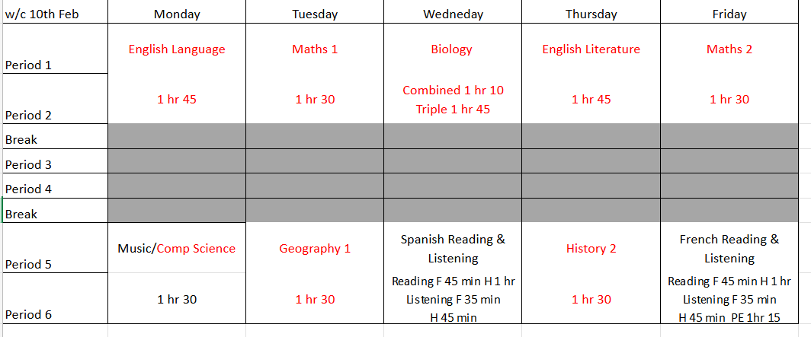
PPE Timetable
Dream BIG // Work Hard // Be Kind
@HanhamWoods
Notes:
Welcome – privielegd to be here today.

Slide 21
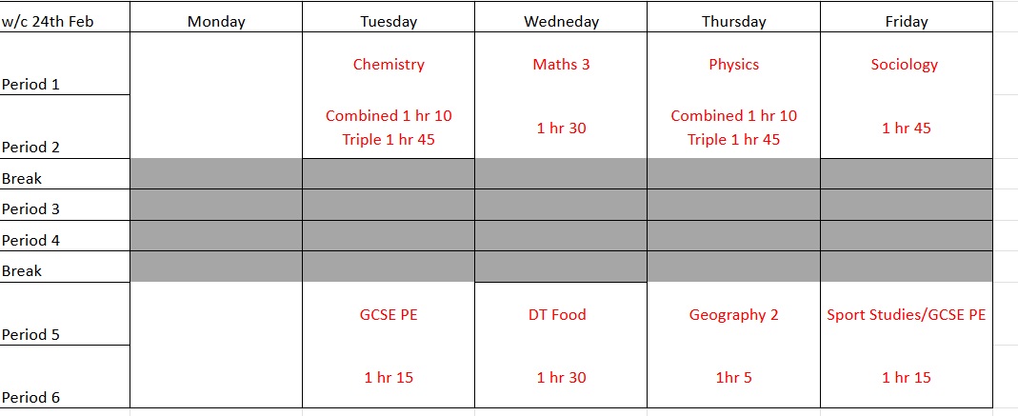
PPE Timetable
Dream BIG // Work Hard // Be Kind
@HanhamWoods
Notes:
Welcome – privielegd to be here today.

Slide 22
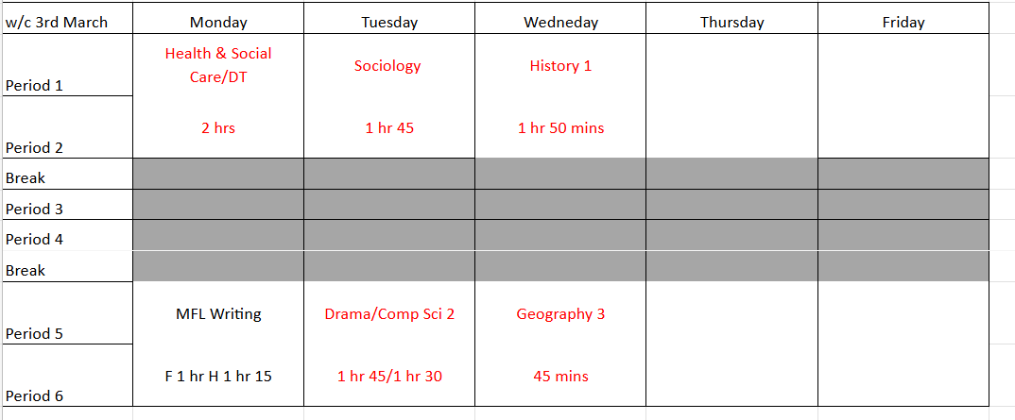
PPE Timetable
Dream BIG // Work Hard // Be Kind
@HanhamWoods
Notes:
Welcome – privielegd to be here today.

Slide 23
Are you exam ready?
Little details matter!
Dream BIG // Work Hard // Be Kind
@HanhamWoods
Notes:
Welcome – privielegd to be here today.

Slide 24
Thank you!
Maths – Josh.hocking@clf.uk
English – Abi.morgan-patel@clf.uk
Science – Sara.Thomas@clf.uk
Pastoral Support - Kelly.Thorne@clf.uk
Dream BIG // Work Hard // Be Kind
@HanhamWoods
Notes:
Welcome – privielegd to be here today.

