Slide 1
Mission: Hanham Woods will give people the best chance of success...
Academically​ | Professionally | Socially | Personally | Within the community
Bronze D of E Expedition Information Evening
4th February 2025
E Baker – D of E Manager
J. Littlejohns – Deputy D of E Manger
Dream BIG // Work Hard // Be Kind
@HanhamWoods
Notes:
Welcome – privielegd to be here today.

Slide 2
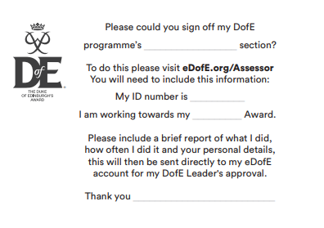
Duke of Edinburgh Award
Four sections
Volunteering
Physical
Skills
Expedition
One section for 6 months, and the other two sections for 3 months
At the end of their volunteering, physical, skills section they need to get their assessor to complete a report.
Dream BIG // Work Hard // Be Kind
@HanhamWoods
Notes:
Welcome – privielegd to be here today.

Slide 3
Logistics – Drop off and collection – training days – Year 9
Refer to the sheet on the front of your pack.
Full kit bag required, with the exception of breakfast and evening meal not required.
Dream BIG // Work Hard // Be Kind
@HanhamWoods
Notes:
Welcome – privielegd to be here today.

Slide 4
Emergency Contact and mobile phones
Emergency contact can be made via staff using either of these contact numbers:
07551182978
07551182982
Mrs Baker & Mr Littlejohns + extra school staff sleeping over on the Friday evening of the assessed expedition
Members of staff from expedition company will be leading the weekend
Mobile phones – we can’t ban phones but they are not to be used, off in bag for emergency only. All students to download the what 3 words app
Please can any contact be made via staff mobile and not directly with students
Dream BIG // Work Hard // Be Kind
@HanhamWoods
Notes:
Welcome – privielegd to be here today.

Slide 5
Kit and rucksack packing
Please refer to the kit list
Weather dependent but waterproofs – top and trousers essential
Sturdy footwear – boots with ankle support ideal
Maps, compasses, tents and cooking equipment are provided by JC Adventures
Dream BIG // Work Hard // Be Kind
@HanhamWoods
Notes:
Welcome – privielegd to be here today.

Slide 6
Rucksack Packing – tips and tricks
Waterproof EVERYTHING! Spare plastics bags, line inside of rucksack with durable bin bag
Put your sleeping bag at the bottom
Don’t hang stuff on the outside
No more than ¼ your body weight
Learn how to adjust your rucksack – weight should be on hip straps not shoulders
We will provide students with a rucksack liner
We have a number of rucksacks that can be borrowed, please get in touch if needed
Dream BIG // Work Hard // Be Kind
@HanhamWoods
Notes:
Welcome – privielegd to be here today.

Slide 7
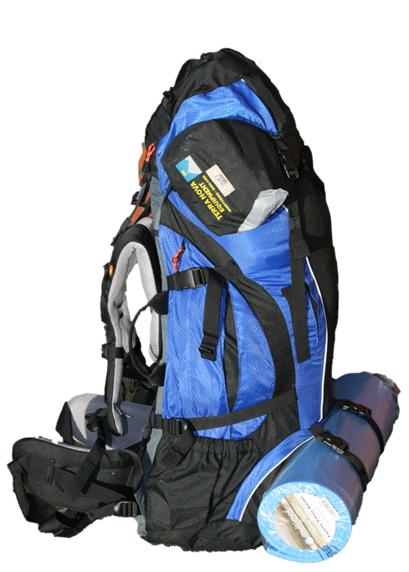
Rucksack
Principle 1: Heavy items should be close to your back, evenly weighted (side to side) and nearer the top
Principle 2: Items you may need should be accessible
Principle 3: Ensure that you can lift the bag! Carrying for approx. 6hrs each day
Dream BIG // Work Hard // Be Kind
@HanhamWoods
Notes:
Welcome – privielegd to be here today.

Slide 8
Other kit considerations
Sleep mat – not yoga mat – self inflatable ones are best but slightly more expensive
Check weather a few days before
Sleeping bag – check season and temperature recommendation. Sleep with clothes on
Share items across group – travel bottles eg washing up liquid
Face wipes rather than bottles of toiletries etc
Most outdoor shops will offer D of E discount – 10 or 15%
Dream BIG // Work Hard // Be Kind
@HanhamWoods
Notes:
Welcome – privielegd to be here today.

Slide 9
Food and menu planning
Packed lunch, dinner, breakfast, lunch, snacks
Food choices are key to your expedition success
You have to carry everything for the entire expedition
Much of this is down to personal taste
However, cooking in a team will save time, effort and fuel – boiling water in one go
Dream BIG // Work Hard // Be Kind
@HanhamWoods
Notes:
Welcome – privielegd to be here today.

Slide 10
Food and menu planning
Other considerations
Weight
Speed and ease of preparation
Tastiness and variety
Durability and longevity (pitta, bagels, wraps are good)
Calorific intake – you will eat more than you usually do (not just sugar, carbs, bananas)
Dream BIG // Work Hard // Be Kind
@HanhamWoods
Notes:
Welcome – privielegd to be here today.

Slide 11
Food and menu planning
Breakfast and Lunch
Porridge is great for breakfast
Have a hot drink lined up for breakfast too
Other than porridge breakfast and lunch are usually the same sort of items
Please don’t plan to cook for lunch
Dream BIG // Work Hard // Be Kind
@HanhamWoods
Notes:
Welcome – privielegd to be here today.

Slide 12
Food and menu planning
Evening Meal
There are 3 basic types of evening meal
Dehydrated
Boil in the bag
Cooking from scratch
Dream BIG // Work Hard // Be Kind
@HanhamWoods
Notes:
Welcome – privielegd to be here today.

Slide 13
Food and menu planning
No tins/cans heavy items
No “normal” rice too long to cook and uses too much gas – microwave or pre packed
Separate snacks labelled “emergency rations” couple of Marsbars etc
No Pot Noodles – limited nutrition
Dream BIG // Work Hard // Be Kind
@HanhamWoods
Notes:
Welcome – privielegd to be here today.

Slide 14
Behaviour & attitude
Normal academy expectations
Mobile phone policy
Indirect supervision
Dream BIG // Work Hard // Be Kind
@HanhamWoods
Notes:
Welcome – privielegd to be here today.

Slide 15
Student Meetings
^{After school meetings}
Thursday 6th March
Thursday 13th March
Organise groups
Final planning
Dream BIG // Work Hard // Be Kind
@HanhamWoods
Notes:
Welcome – privielegd to be here today.

Slide 16
What can you do to help?
Walking boots - have been 'broken in'.
Go out for walks – the longer the better.
Practice pack, and practice carry.
^{Practice using a compass!}
Encourage your child to finish the other sections and get their assessor reports submitted, so the expedition is the 'final thing'.
Dream BIG // Work Hard // Be Kind
@HanhamWoods
Notes:
Welcome – privielegd to be here today.

Slide 17
Please ensure any final payments have been made
Follow @HWADofE
Any questions?
Email – Emily.baker@clf.uk
Dream BIG // Work Hard // Be Kind
@HanhamWoods
Notes:
Welcome – privielegd to be here today.

Slide 18
Mission: Hanham Woods will give people the best chance of success...
Academically​ | Professionally | Socially | Personally | Within the community
Dream BIG
Work Hard
Be Kind
Dream BIG // Work Hard // Be Kind
@HanhamWoods
Notes:
Welcome – privielegd to be here today.

